Slide 1


Solar wind data assimilation in an operational context
Use of near-real-time data and the forecast value of an L5 monitor
Harriet Turner
Supervisors: Mathew Owens, Matthew Lang, Mike Marsh and Siegfried Gonzi

Slide 2
THE SOLAR WIND
Constant stream of charged particles that flows off the Sun and fills the heliosphere (solar system)
Comprised mostly of electrons, protons and ions

Slide 3
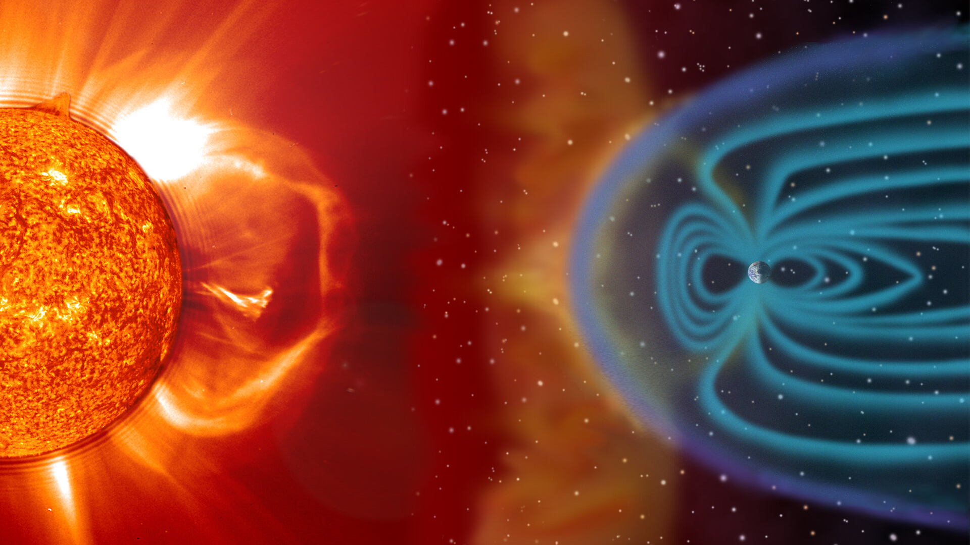
TITLE
Text

Slide 4
SOLAR WIND STRUCTURE
Solar wind drags out the Sun’s magnetic field
Pulled into an Archimedean spiral due to the Sun’s rotation
Solar wind flow is mostly radial

Slide 5
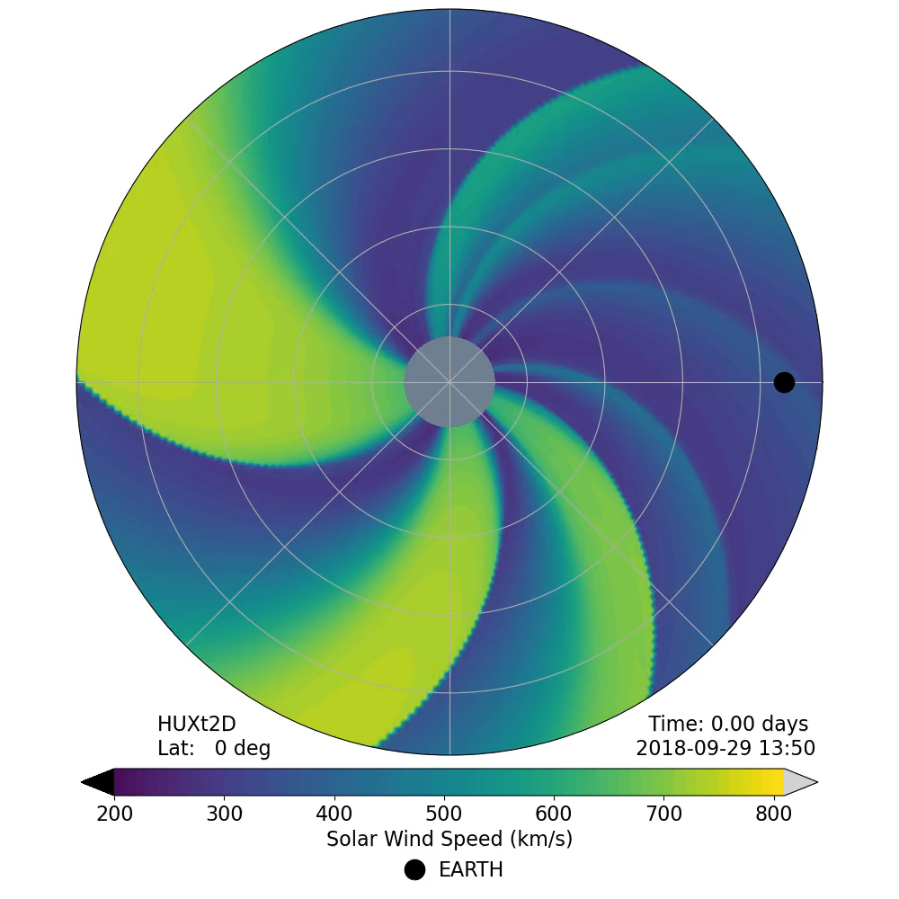

Slide 6
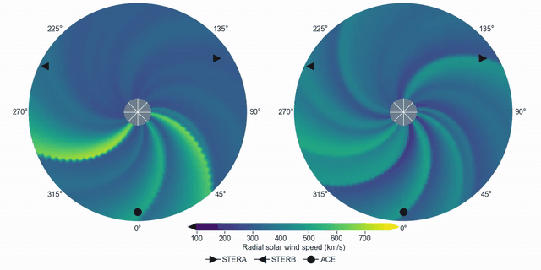
CORONAL MASS EJECTIONS
Coronal mass ejections (CMEs) are huge eruptions of solar material and are the main driver of severe space weather
They propagate through the solar wind, so the background conditions affect their speed and arrival time

Slide 7
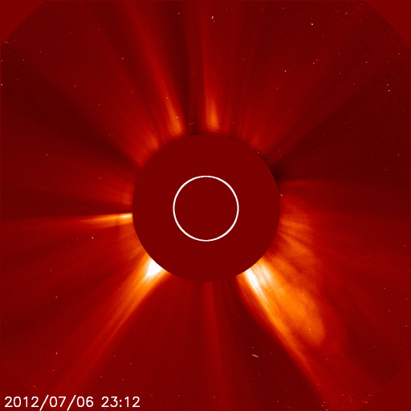
TITLE
Text

Slide 8
WHY SHOULD WE CARE?
Space weather (the changing plasma conditions in near-Earth space) poses a significant threat to modern technology
Extreme space weather is in the UK’s National Risk Register

Slide 9
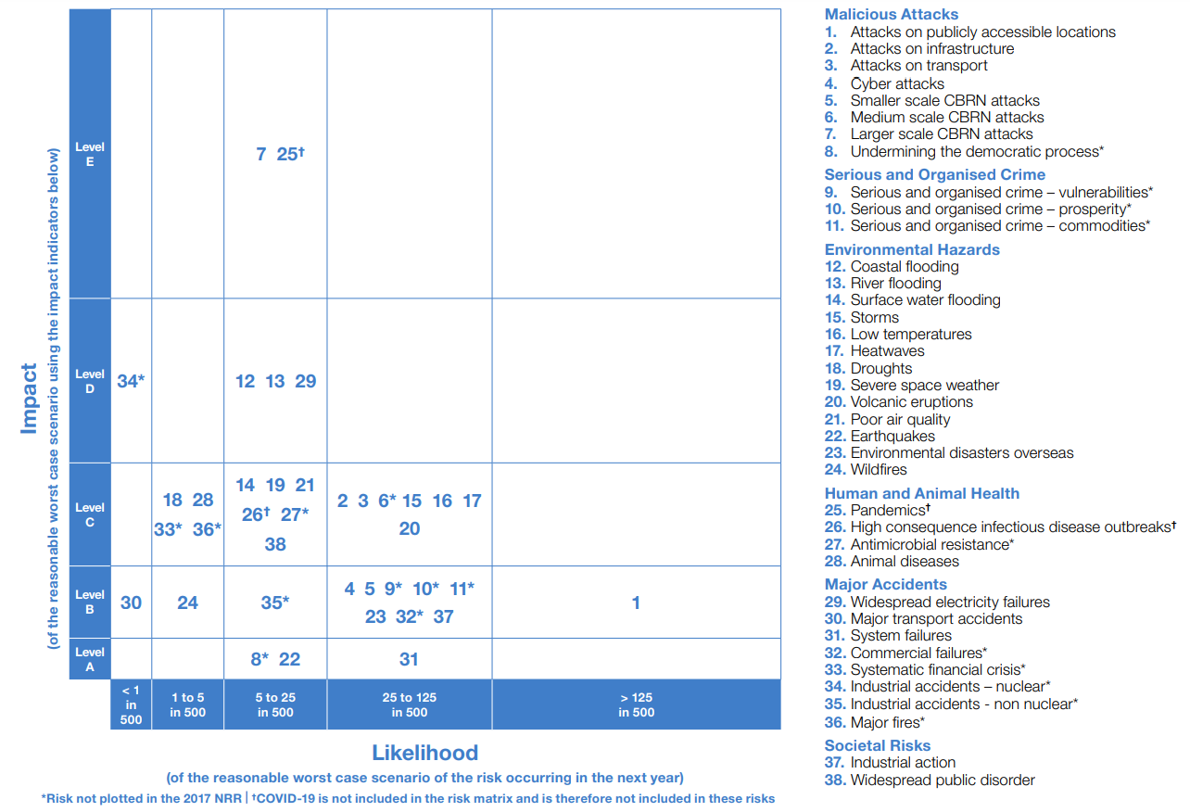

Slide 10
Pandemics

Slide 11
Pandemics

Slide 12
Coastal and river flooding

Slide 13
Heatwaves

Slide 14
Severe space weather

Slide 15
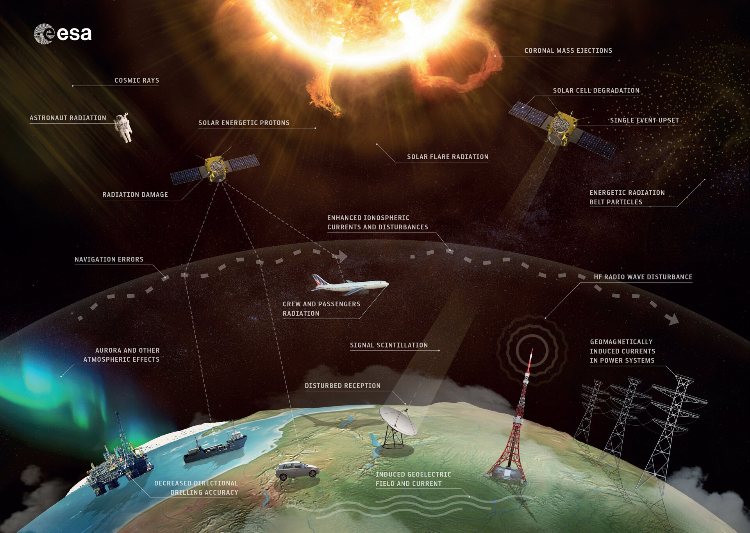
TITLE
Text

Slide 16
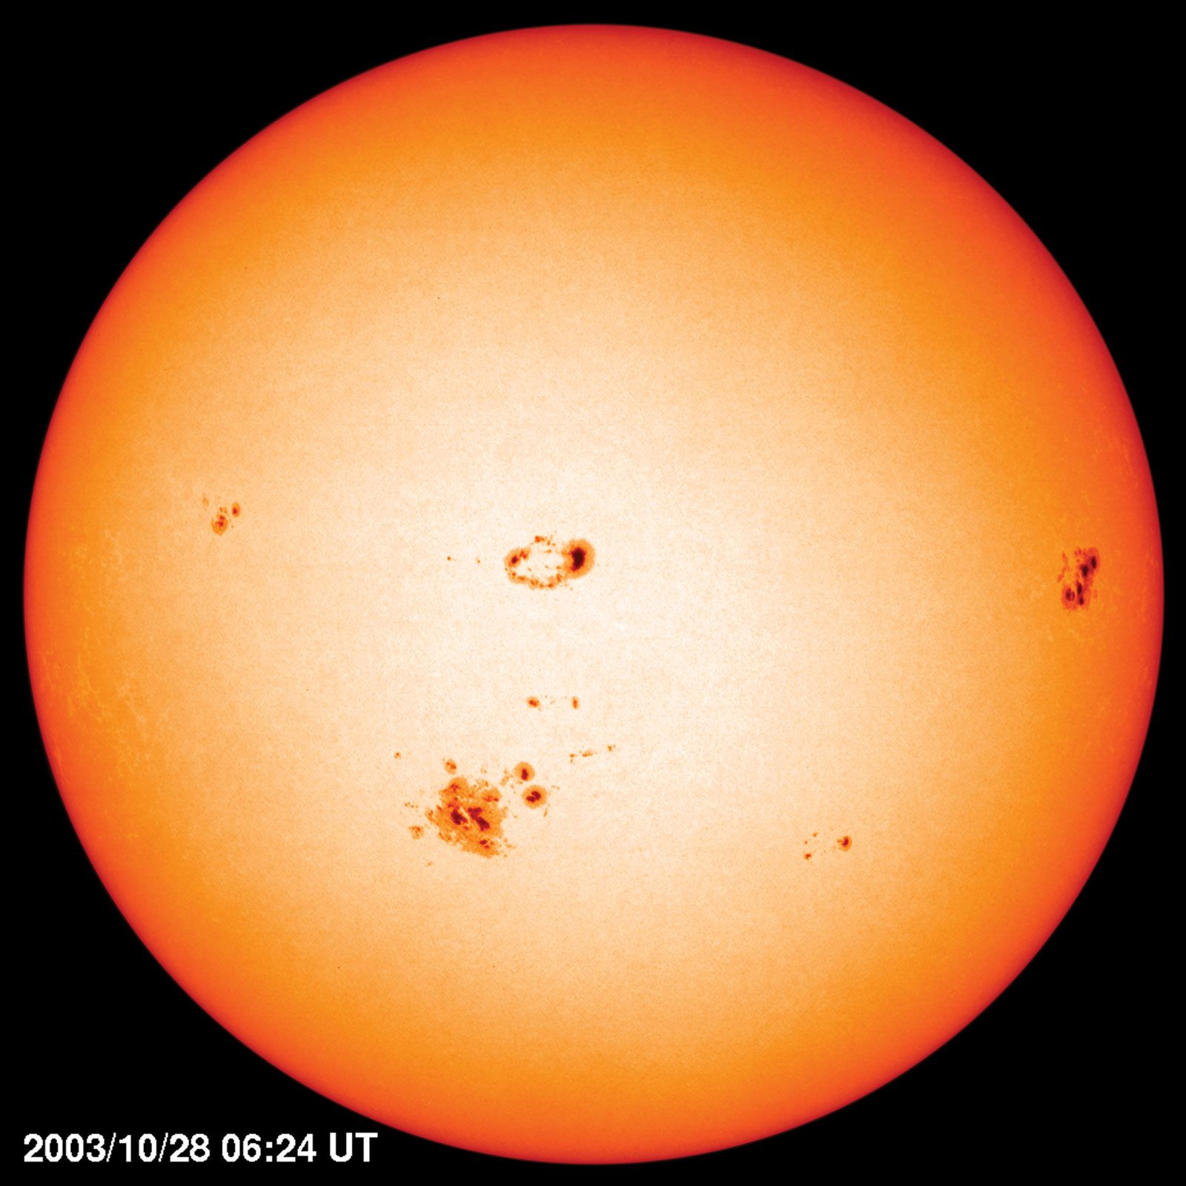
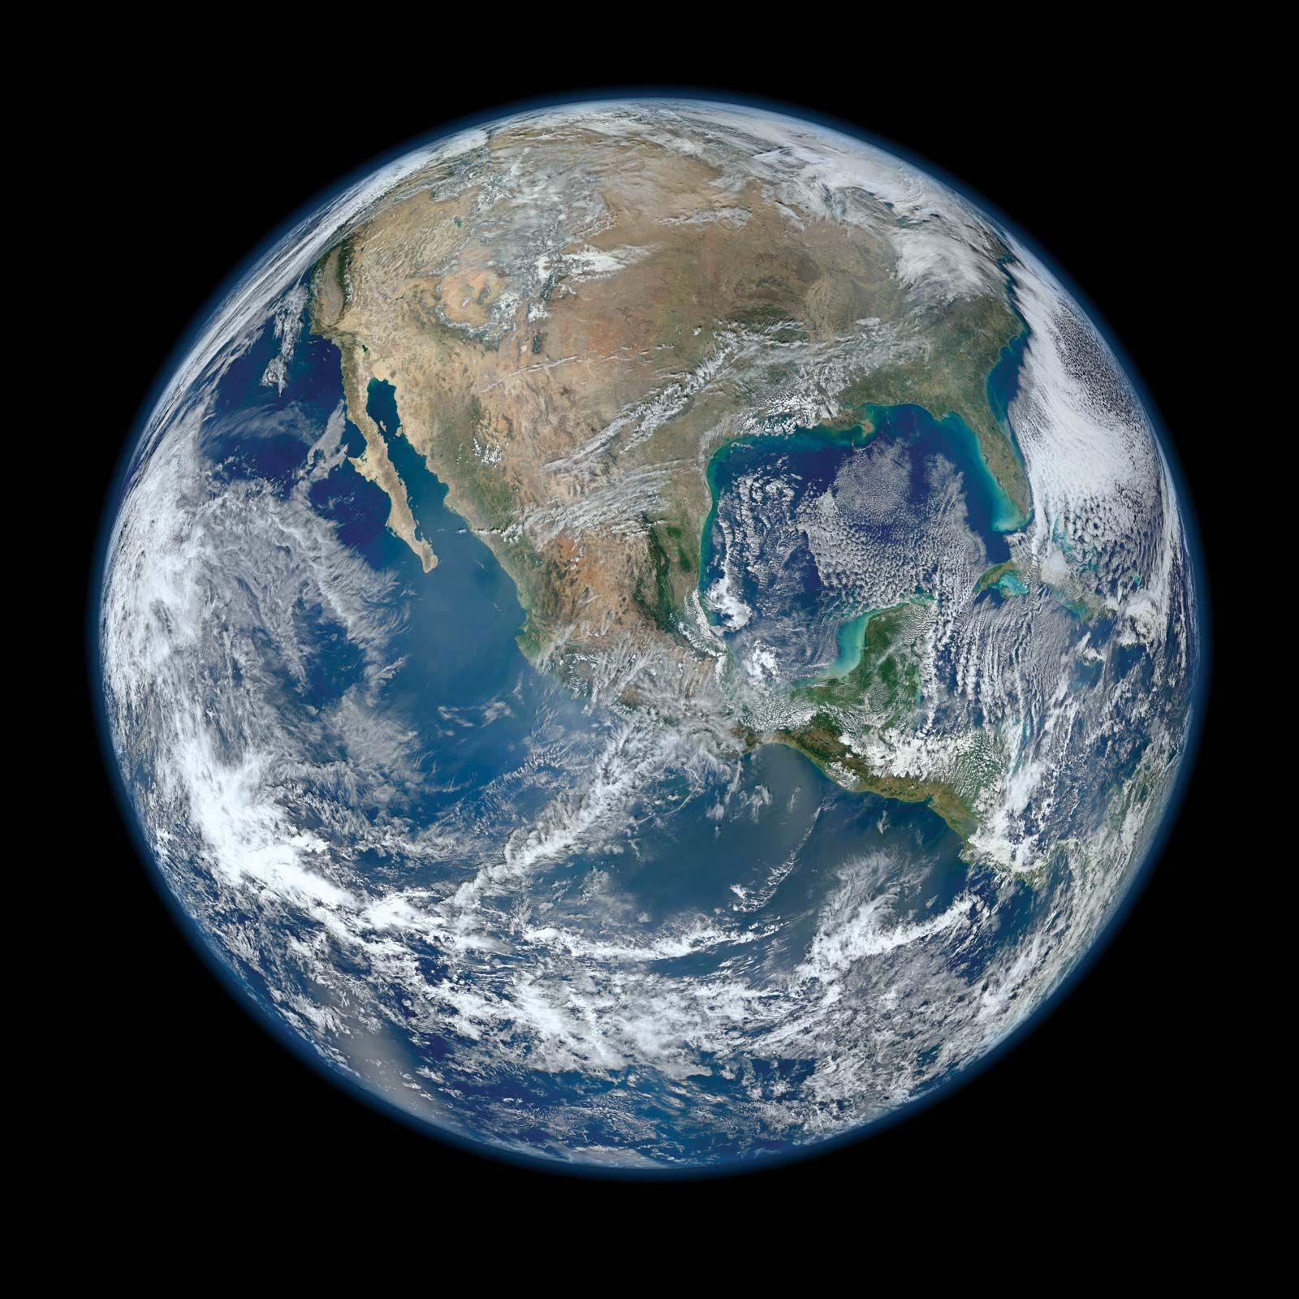
CURRENT FORECASTING
Typically a coronal model coupled to a heliospheric model
1 AU

Slide 17
CURRENT FORECASTING
Typically a coronal model coupled to a heliospheric model
1 AU

Slide 18
CURRENT FORECASTING
Typically a coronal model coupled to a heliospheric model
Photospheric observations
1 AU

Slide 19
CURRENT FORECASTING
Typically a coronal model coupled to a heliospheric model
WSA
1 AU

Slide 20
CURRENT FORECASTING
Typically a coronal model coupled to a heliospheric model
0.1 AU
1 AU

Slide 21
CURRENT FORECASTING
Typically a coronal model coupled to a heliospheric model
0.1 AU
1 AU

Slide 22
CURRENT FORECASTING
Typically a coronal model coupled to a heliospheric model
V
0.1 AU
1 AU

Slide 23
CURRENT FORECASTING
Typically a coronal model coupled to a heliospheric model
V
0.1 AU
B
1 AU

Slide 24
CURRENT FORECASTING
Typically a coronal model coupled to a heliospheric model
V
0.1 AU
B
1 AU

Slide 25
CURRENT FORECASTING
Typically a coronal model coupled to a heliospheric model
V
0.1 AU
Enlil
B
1 AU

Slide 26
CURRENT FORECASTING
Typically a coronal model coupled to a heliospheric model
V
V
B
0.1 AU
Enlil
n
B
T
1 AU

Slide 27
CURRENT FORECASTING
Typically a coronal model coupled to a heliospheric model
V
V
B
0.1 AU
Enlil
n
B
T
1 AU

Slide 28
DATA ASSIMILATION (DA)
Data assimilation combines prior information, usually from a model, with observations to find an optimum estimation of reality
Used in numerical weather prediction and has led to large forecast improvements
Underused in space weather

Slide 29
DA IN SPACE WEATHER
DA is in its infancy in space weather forecasting
Has been used in 3 main areas – the photosphere, solar wind and ionosphere

Slide 30
TITLE
Text
Ionosphere –
where Earth’s atmosphere reaches space
Photosphere – lowest layer of the Sun’s atmosphere that is observable
Solar wind

Slide 31
DA IN THE SOLAR WIND
I have been using the Burger Radius Variational Data Assimilation (BRaVDA) scheme developed at the University of Reading (Lang et al., 2019)
Combines observations with a steady-state solar wind model
Prior inner boundary condition from a coronal model

Slide 32


Slide 33
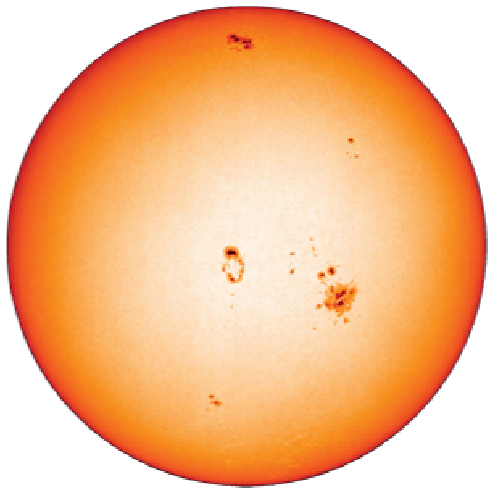

Slide 34
Time = t₀
= observation
Notes:
Assimilating a single observation

Slide 35

Time = t₀
= observation

Slide 36
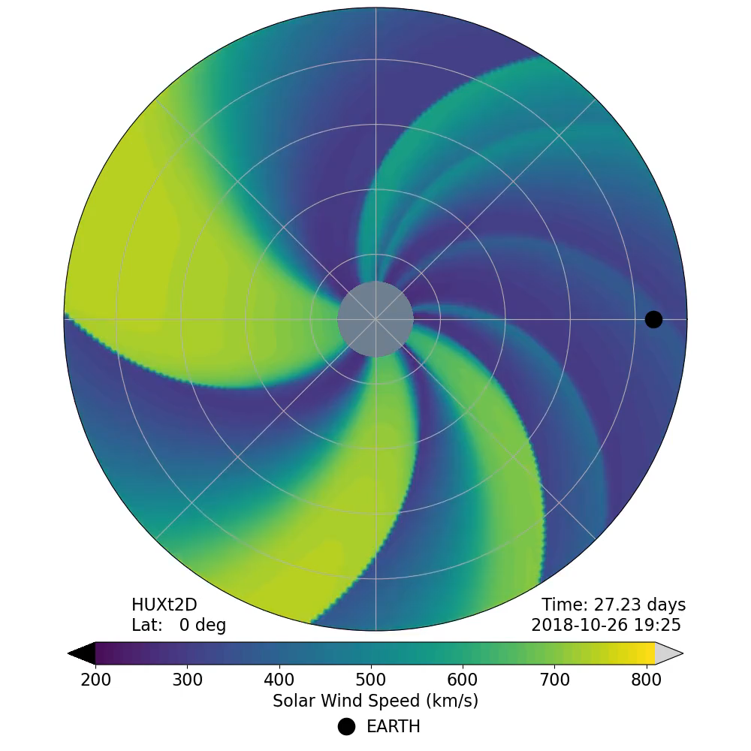
– Δt
Time = t₀
= observation

Slide 37
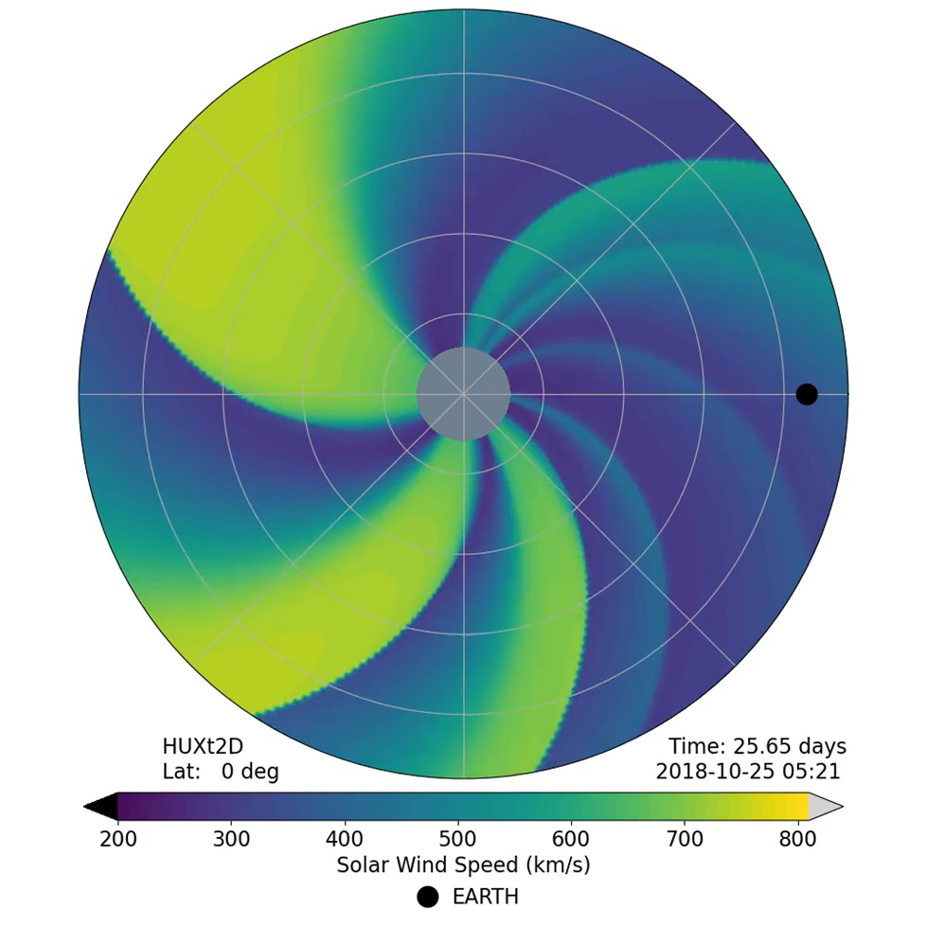
– Δt
Time = t₀
= observation

Slide 38
Time = t₀ – Δt
= observation

Slide 39
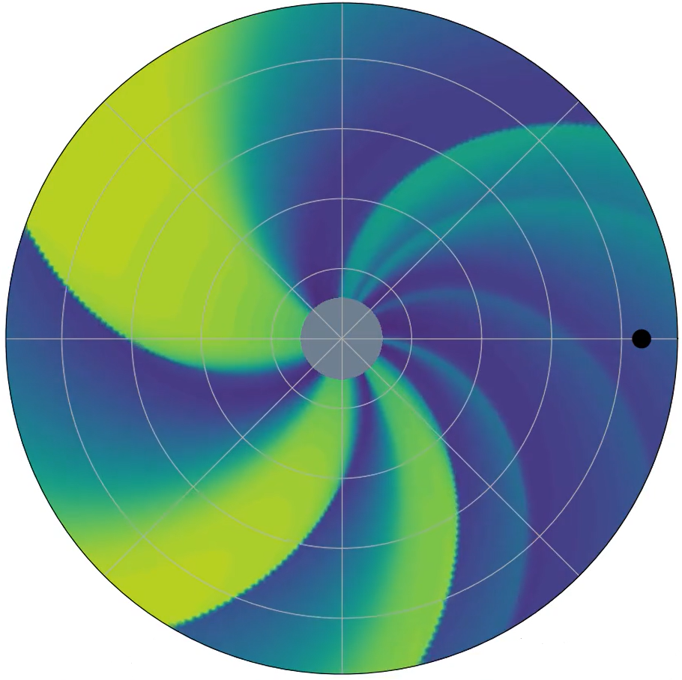
Time = t₀ – Δt
= observation

Slide 40
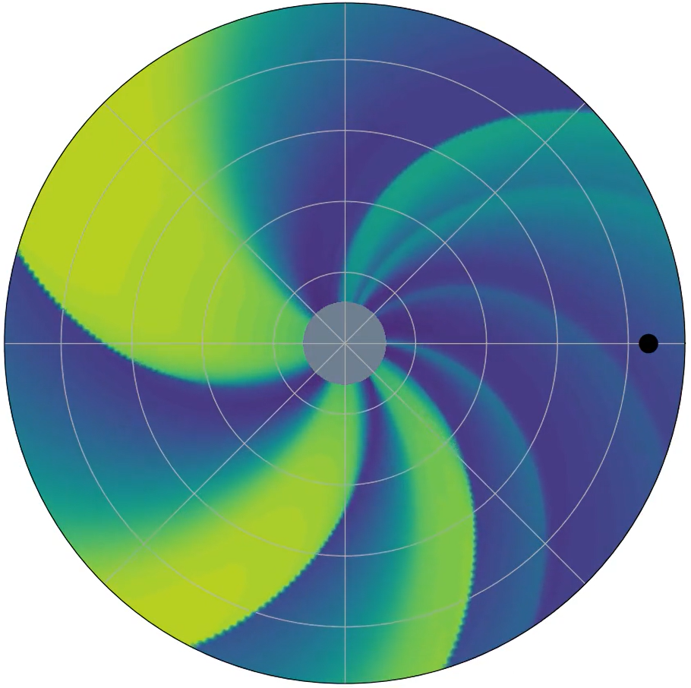
Time = t₀ – Δt
= observation

Slide 41
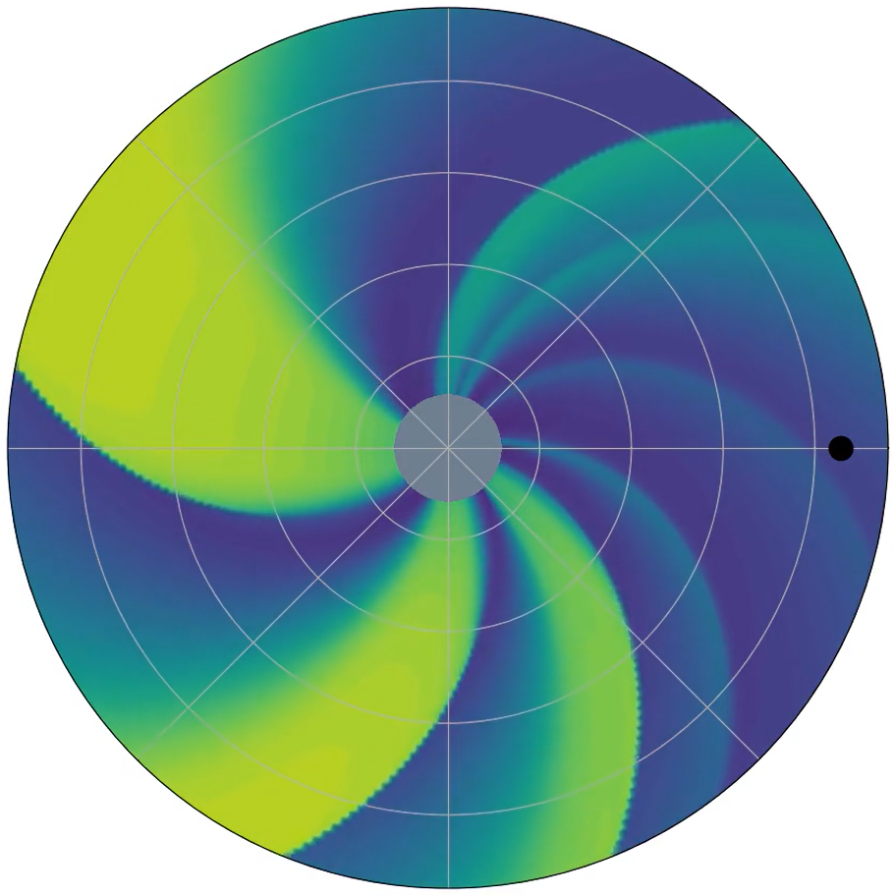
Time = t₀ – Δt
= observation

Slide 42
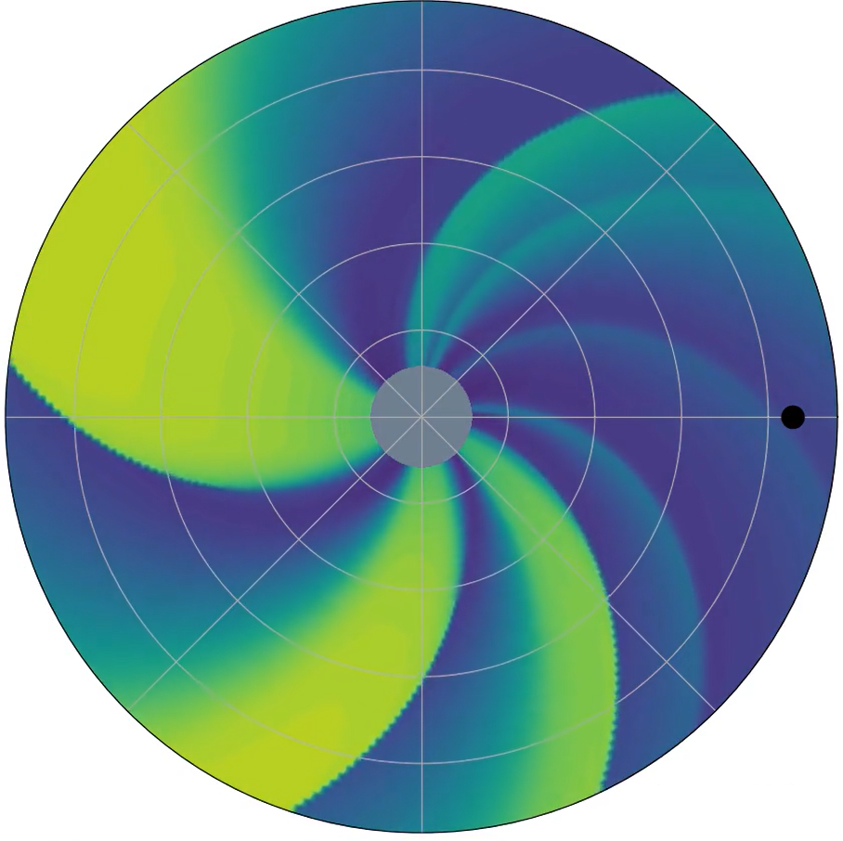
Time = t₀ – Δt
= observation

Slide 43
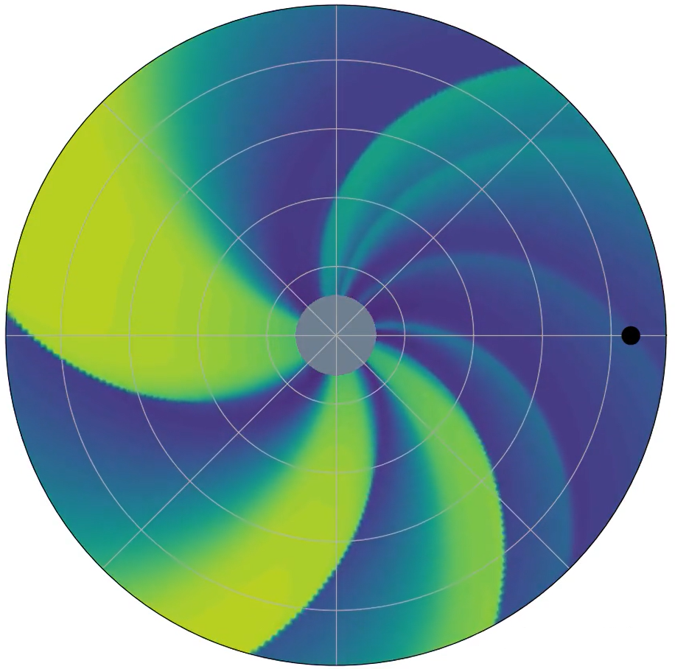
Time = t₀ – Δt
= observation

Slide 44
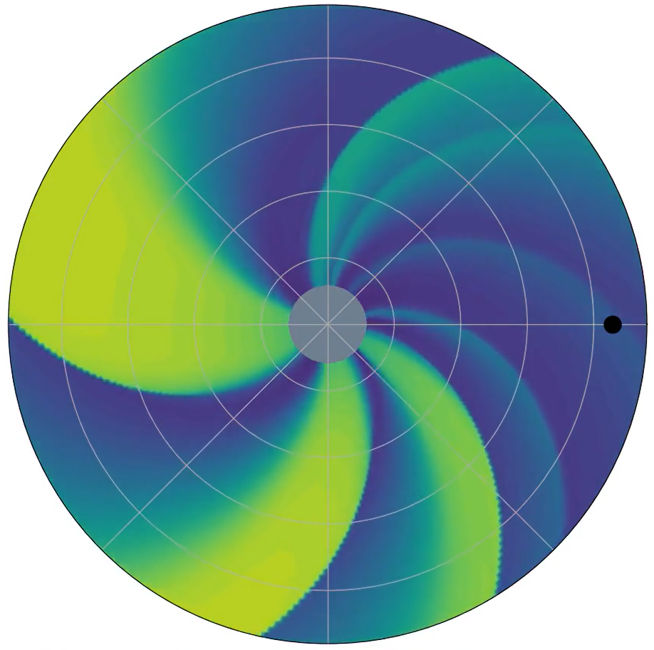
Time = t₀
= observation

Slide 45
Time = t₀
= observation

Slide 46
Time = t₀
= observation

Slide 47
Time = t₀
= observation

Slide 48
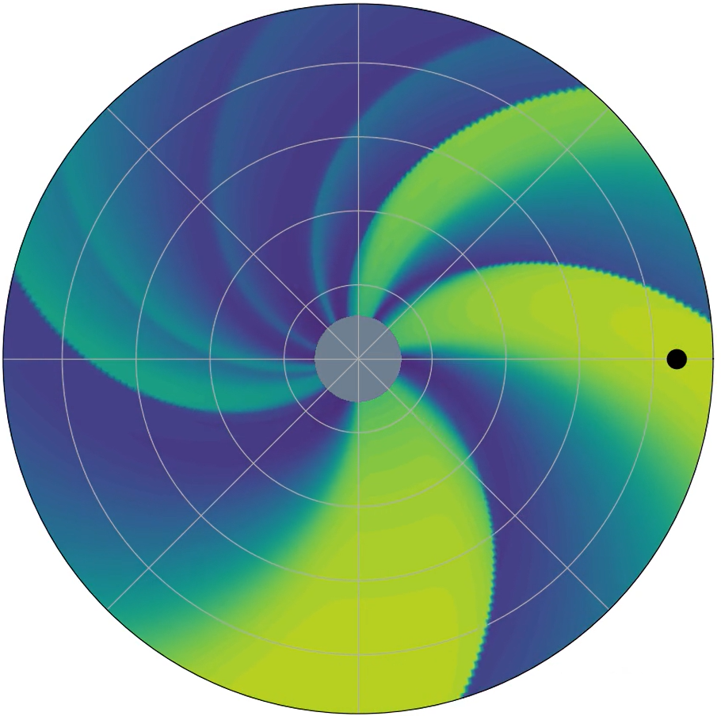
Time = t₀ + Δt
= observation

Slide 49
CURRENT FORECASTING
Typically a coronal model coupled to a heliospheric model
V
V
B
0.1 AU
MHD
n
B
T
1 AU

Slide 50
COROTATION USING DA
Typically a coronal model coupled to a heliospheric model
V
0.1 AU
B
1 AU

Slide 51
COROTATION USING DA
Typically a coronal model coupled to a heliospheric model
V
BRaVDA
0.1 AU
B
1 AU

Slide 52
COROTATION USING DA
Typically a coronal model coupled to a heliospheric model
V_{obs}
V
BRaVDA
0.1 AU
B
1 AU

Slide 53
COROTATION USING DA
Typically a coronal model coupled to a heliospheric model
V_{obs}
V
BRaVDA
V_{updated}
0.1 AU
B
1 AU

Slide 54
COROTATION USING DA
Typically a coronal model coupled to a heliospheric model
V_{obs}
V
BRaVDA
V_{updated}
0.1 AU
B
1 AU

Slide 55
OBSERVATIONS – STEREO
Solar Terrestrial Relations Observatory Ahead and Behind – STEREO-A and B
Earth-like orbits, but separating in longitude
Launched in 2007
Communication with STEREO-B lost in 2014

Slide 56
OBSERVATIONS – ACE & DSCOVR
Advanced Composition Explorer – ACE (launched 1997)
Deep Space Climate Observatory – DSCOVR (launched 2015)
Both give near-Earth observations from L1

Slide 57
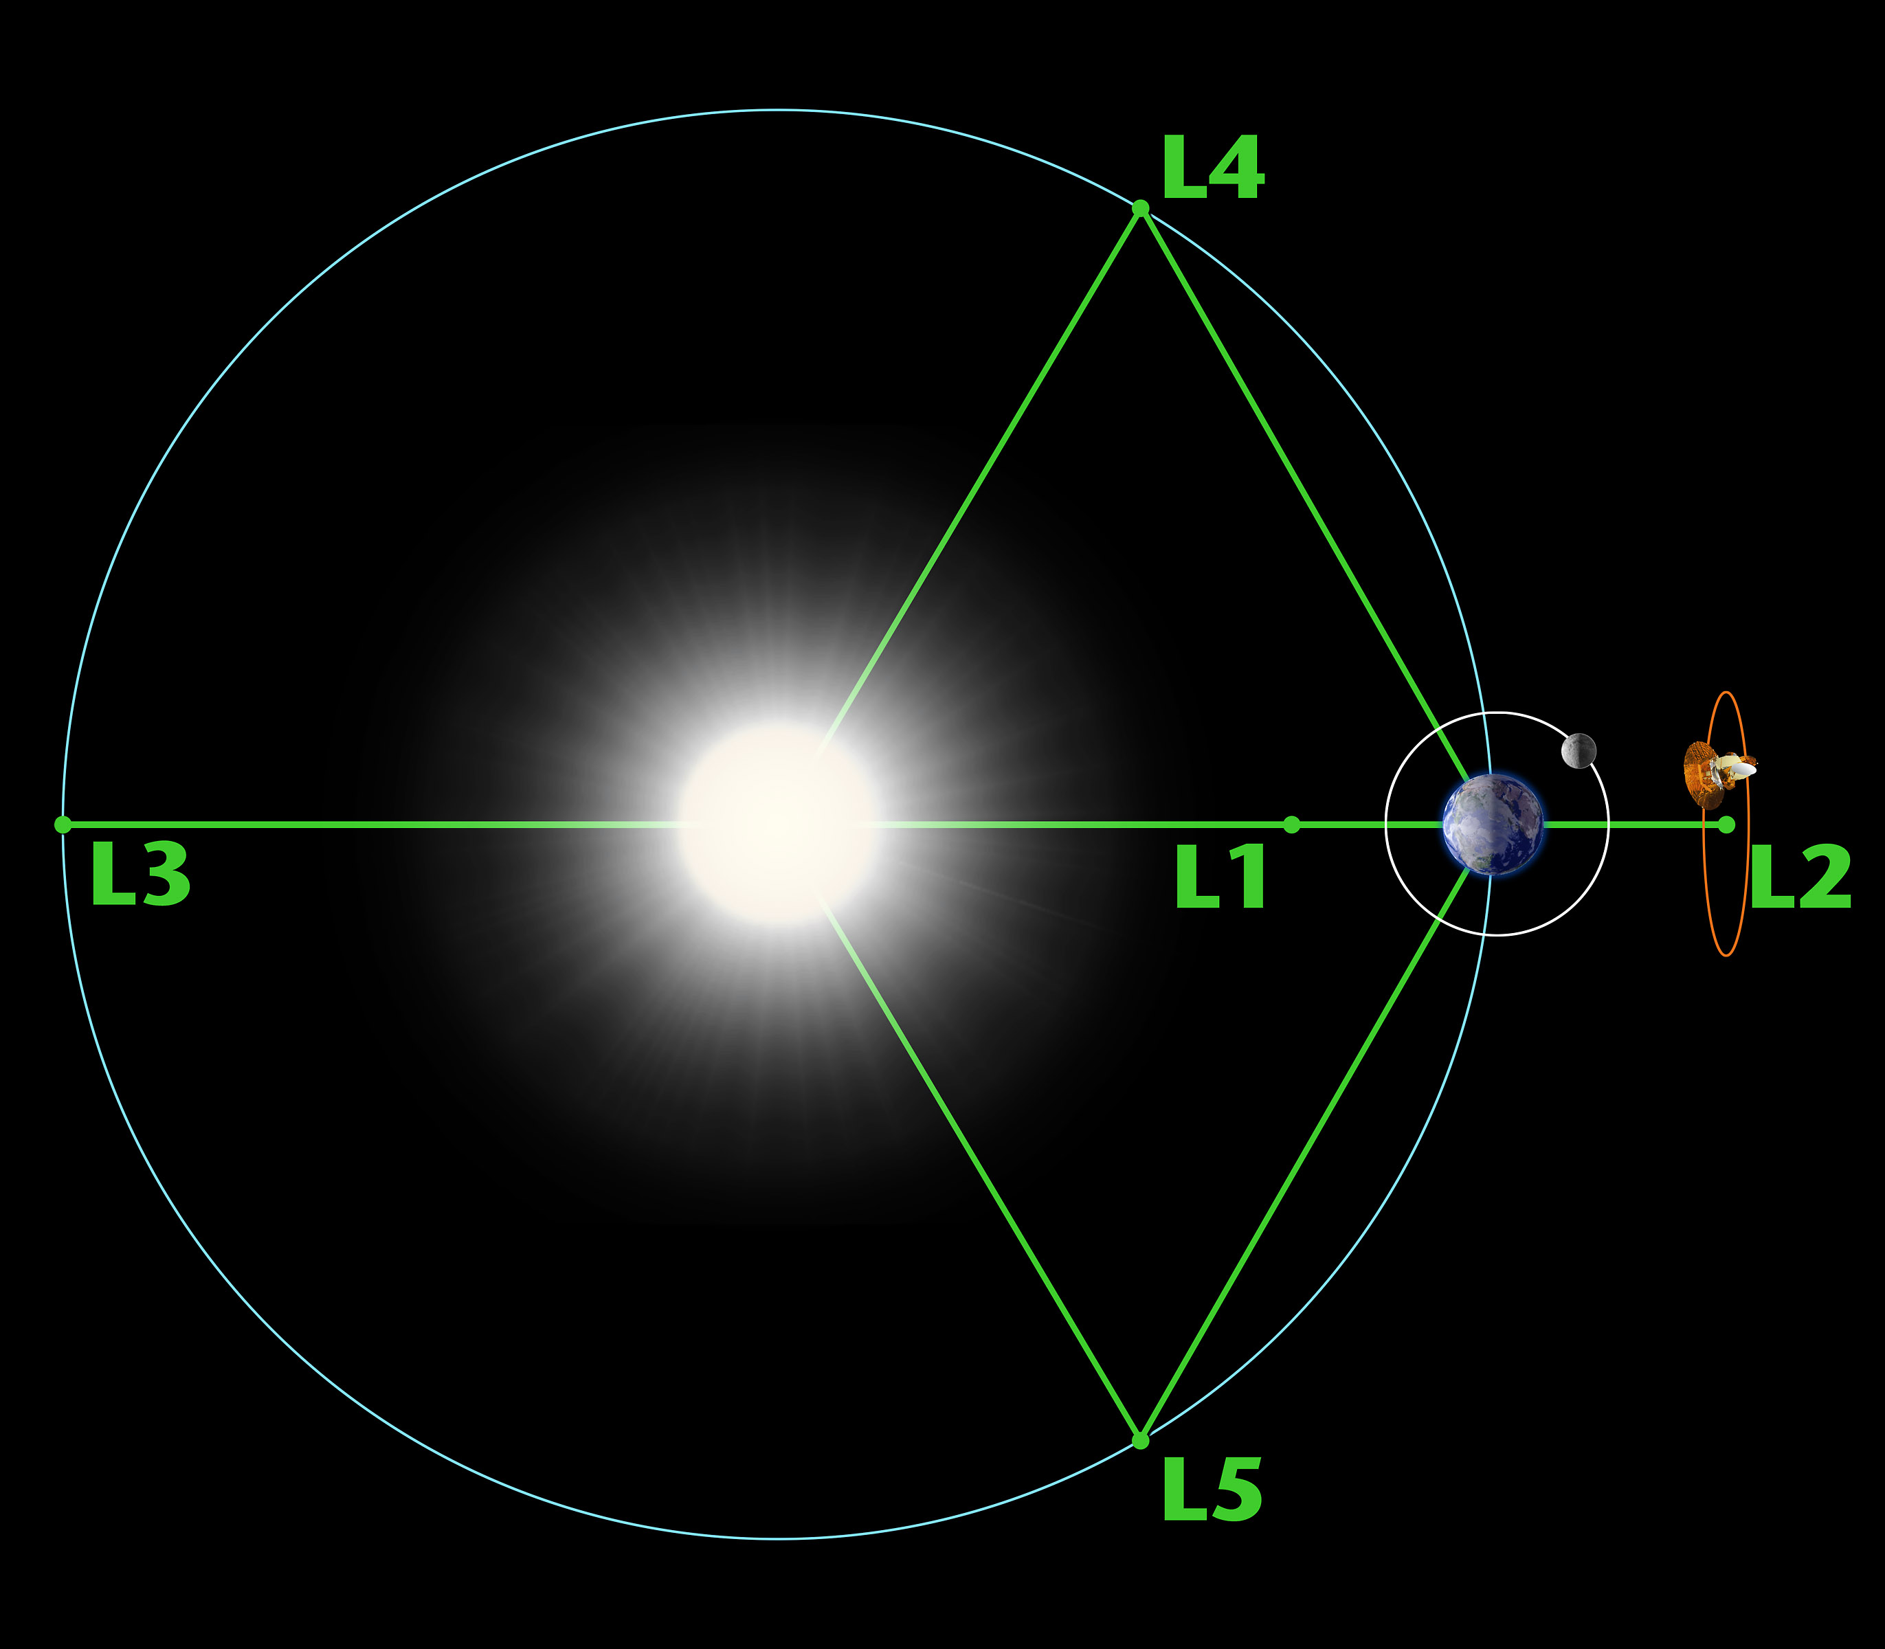
TITLE
Text

Slide 58
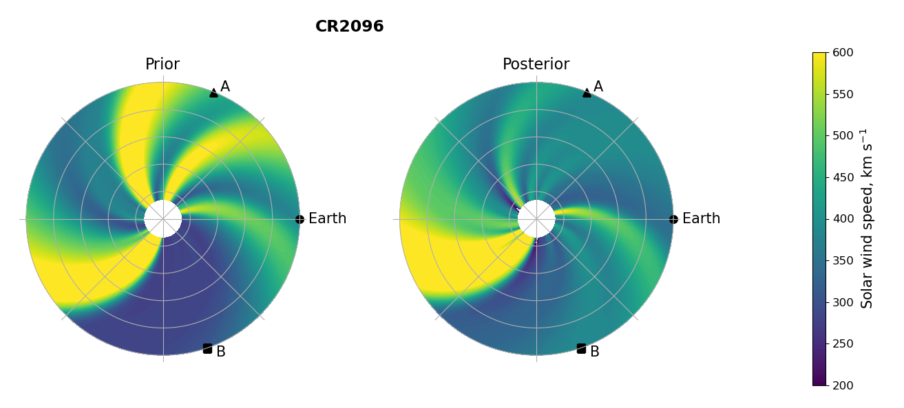
DA OUTPUT – POLAR

Slide 59
FORECASTING USING OUTPUT
t - 27
t
t + 27

Slide 60
FORECASTING USING OUTPUT
Assimilation window
t - 27
t
t + 27

Slide 61
FORECASTING USING OUTPUT
Assimilation window
t - 27
t
t + 27

Slide 62
FORECASTING USING OUTPUT
Assimilation window
Forecast window
t - 27
t
t + 27

Slide 63
OPERATIONAL SOLAR WIND DA
For BRaVDA to be operational, it needs to work with real time data
Previous experiments have used science level data, which has been pre-processed to provide a “cleaner” dataset (e.g. Lang et al., 2021 and Turner et al., 2022)
Removing data gaps, erroneous observations and biases

Slide 64
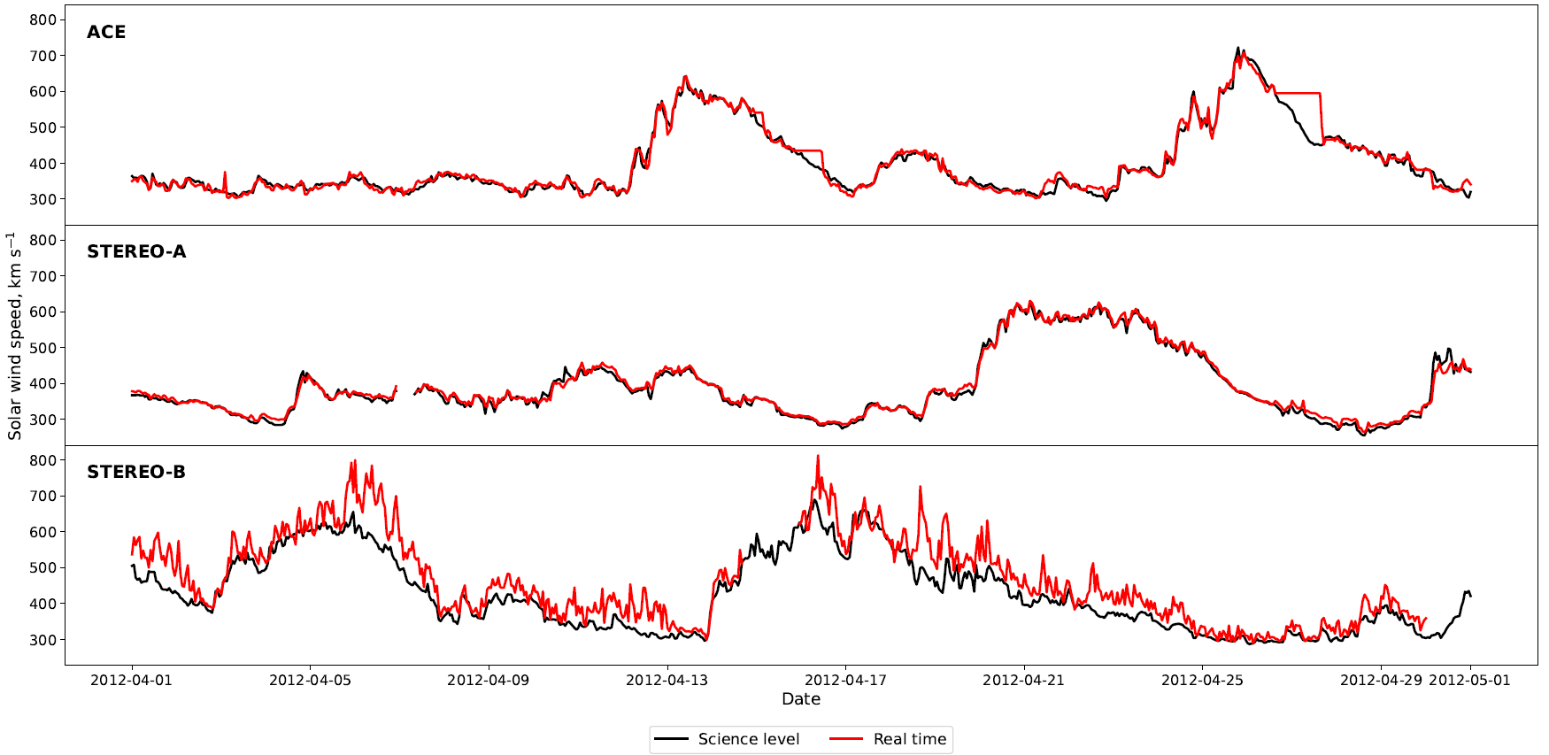
REAL TIME ISSUES

Slide 65
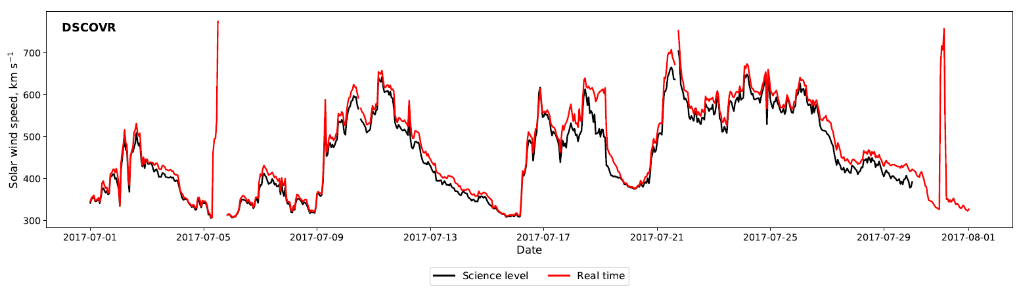
REAL TIME ISSUES

Slide 66
BRaVDA EXPERIMENTS
Assimilating all sources of observations – STEREO-A, B and ACE
Evaluate the forecast accuracy at the three observation locations – verification time series is the science data
Comparing the prior, real time and science forecasts

Slide 67
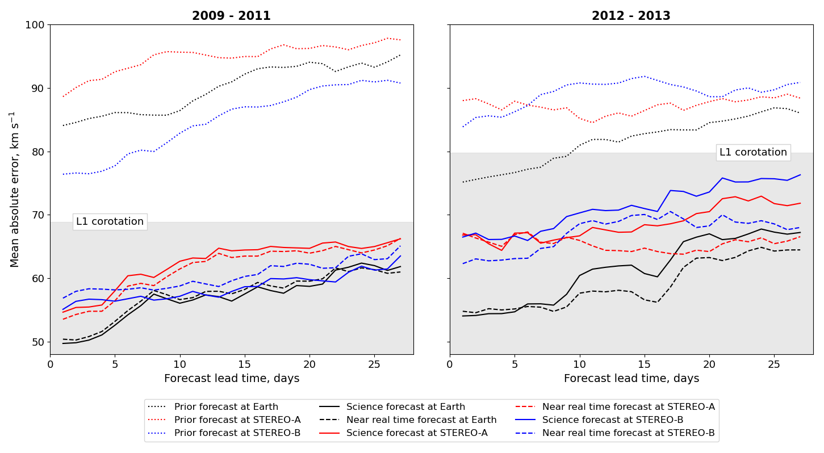
BRaVDA EXPERIMENTS

Slide 68
FUTURE SOLAR WIND DA
The ESA Vigil mission is (hopefully) going to be launched in 2027 (ish) to the L5 point
“The mission will give us advanced warning of oncoming solar storms and therefore more time to protect spacecraft in orbit, infrastructure on the ground and explorers now and in the future, unshielded by Earth’s magnetic field and vulnerable to our star’s violent outbursts.” – ESA, 2023
Could be useful for future operational solar wind DA

Slide 69
L5 & L1 SIMULATION
Combinations of spacecraft separated by approximately 60º in longitude
Historic data to see how well a potential L5 and L1 pairing could work for solar wind DA
4 time periods

Slide 70
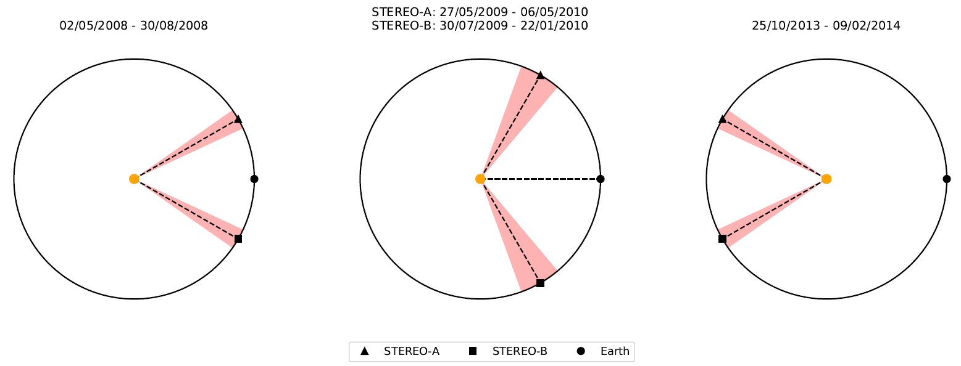
L5 & L1 SIMULATION

Slide 71
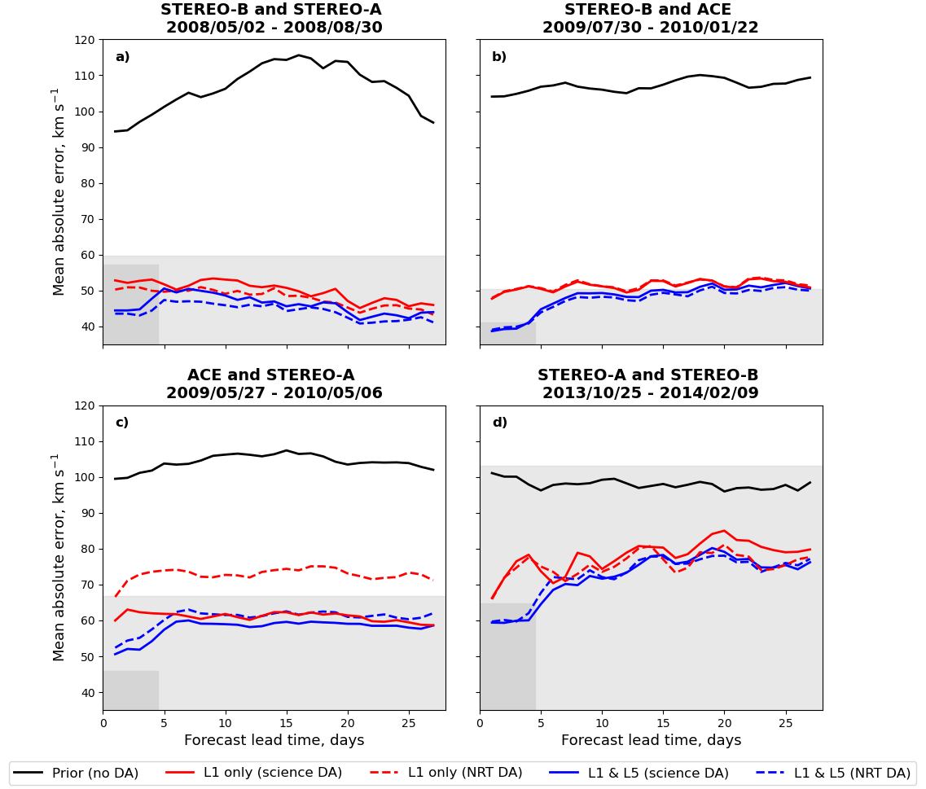

Slide 72
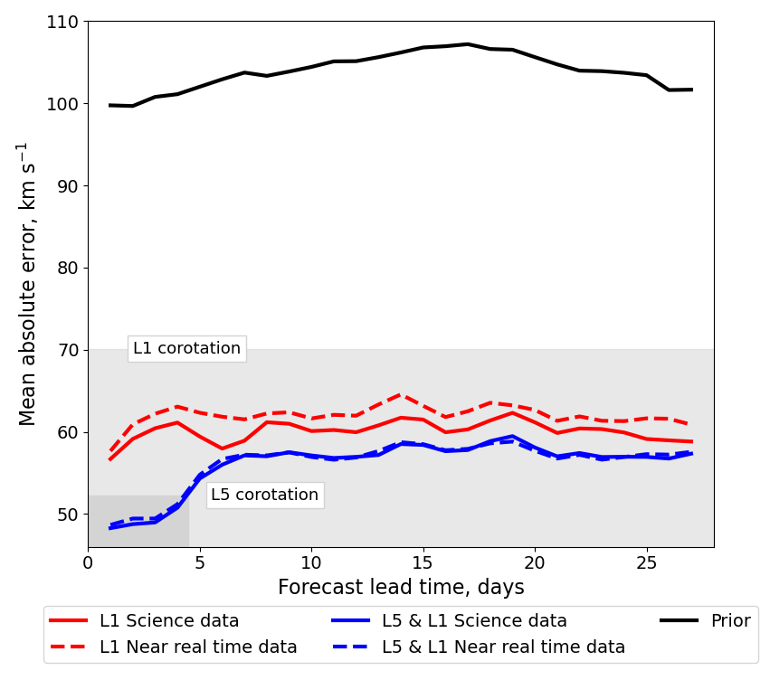
L5 & L1 AVERAGE

Slide 73
FUTURE WORK
I am currently working on a semi-operational version of BRaVDA
All the pieces are there but need pulling together
Hoping for a daily updated forecast – a world’s first using solar wind DA
Something about a thesis?

Slide 74
CONCLUSIONS
Knowledge of the solar wind is important for timely and accurate space weather forecasting
The BRaVDA scheme reconstructs a full solar rotation using available observations
Leads to improved solar wind forecasts
A future L5 & L1 spacecraft pairing could be useful for operational solar wind DA

Slide 75
REFERENCES
ESA, 2023. URL: https://www.esa.int/Space_Safety/Vigil
Lang, M., & Owens, M. J. (2019). A Variational Approach to Data Assimilation in the Solar Wind. Space Weather, 17(1), 59 – 83. DOI: 10.1029/2018SW001857.
Lang, M., Witherington, J., Owens, M. J., & Turner, H. (2021) Improving solar wind forecasting using data assimilation. Space Weather, 1 – 23.
National Risk Register. URL: https://www.gov.uk/government/publications/national-risk-register-2020
Owens, M. J., et al. A Computationally Efficient, Time-Dependent Model of the Solar Wind for use as a Surrogate to Three-Dimensional Numerical Magnetohydrodynamic Simulations. Solar Physics, 295:43. DOI: 10.1007/s11207-020-01605-3.
Turner, H., Owens, M. J., Lang, M., Gonzi, S., & Riley, P. (2022). Quantifying the effect of ICME removal and observation age for in situ solar wind data assimilation. Space Weather, 20. DOI: 10.1029/2022SW003109.

Slide 76

Paper
Turner, H., Lang, M., Owens, M., Smith, A., Riley, P., Marsh, M., & Gonzi, S. (2023). Solar wind data assimilation in an operational context: use of near-real-time data and the forecast value of an L5 monitor. Space Weather, 21, e2023SW003457. https://doi.org/10.1029/2023SW003457

Slide 77
TITLE
Text

